Slide 1
Intro to Data Analysis Tools:
Power BI & Tableau
July 11th, 2018

Slide 2
Agenda

Slide 3
Agenda
Introductions | 5 mins
Intro to Data Analysis | 30 mins
Interactive Demo | 60 mins
Break | 5 mins
Viz-Off Team Activity | 75 mins
Wrap-up/Conclusion | 5 mins

Slide 4

SEC
1
Introductions

Slide 5


Introductions
Name: | Sean Mitchell
Career Track: | Business Analyst
Current Client: | Cargill
Fun Fact: | Played chess and once beat a grandmaster in 6th grade.
Name: | Alex Sorenson
Career Track: | Technical Analyst
Current Client: | LiftPoint Consulting
Fun Fact: | Captained a Robotics Team that got an ‘Innovation Award’ for adding broom to the bot.

Slide 6
SEC
2
Intro to Data Analysis

Slide 7
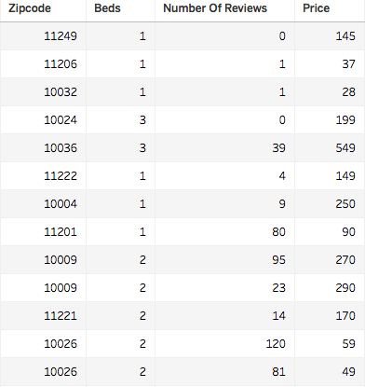
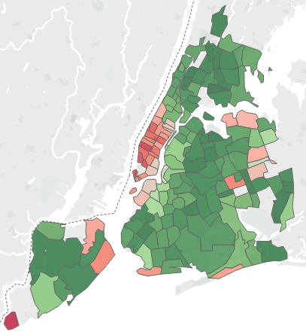
Why Analyze Data?

Slide 8
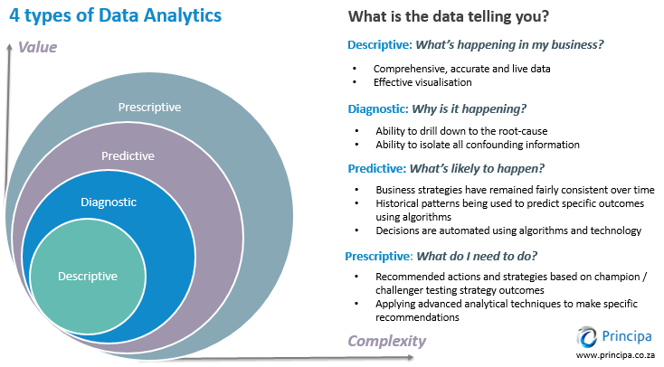
Varieties of Data Analytics
Notes:
Prescriptive – This type of analysis reveals what actions should be taken. This is the most valuable kind of analysis and usually results in rules and recommendations for next steps.
Predictive – An analysis of likely scenarios of what might happen. The deliverables are usually a predictive forecast.
Diagnostic – A look at past performance to determine what happened and why. The result of the analysis is often an analytic dashboard.
Descriptive – What is happening now based on incoming data. To mine the analytics, you typically use a real-time dashboard and/or email reports.

Slide 9
Types of Data Variables
Data Type | Description | Example
STRING | Any sequence of zero or more characters. They are enclosed within single quotes. The quote itself can be included in a string by writing it twice. | Suitcase' ‘Under Utilized' ‘Unknown Category’
NUMBER | These are either integers or floating points. It is advised to round the floating point numbers while using them in calculations. | 3 142.58
BOOLEAN | They are logical values. | TRUE FALSE
DATE & DATETIME | Any format of a date an time | 02/01/2015 #3 March 1982 2015-02-25 22:35:13
Location | Any data that identifies a location. This could be a street, city, state, country, zip code, latitude, longitude, etc. | Minneapolis, MN 55426 44.9778° N, 93.2650° W
Notes:
Why it matters: Tools will try to predict what to do based on data type

Slide 10
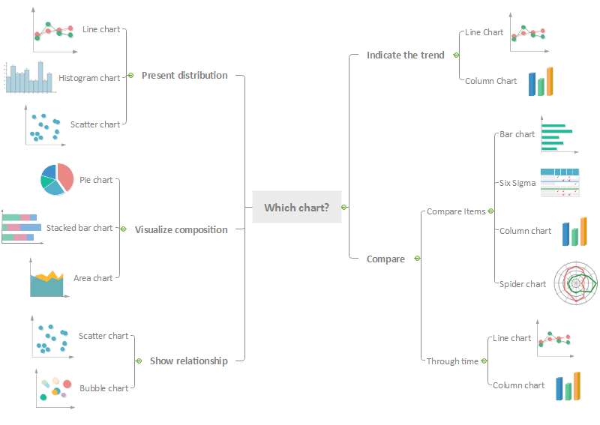
types of Graphs and when to use them
Notes:
Basic Graphs: Bar, Line, Pie
Intermediate Graphs: Combo, Treemap, Scatter Plot, Areagraph/Streamgraph, Waterfall
Advanced Graphs: Packed Bubbles, Filled Map

Slide 11
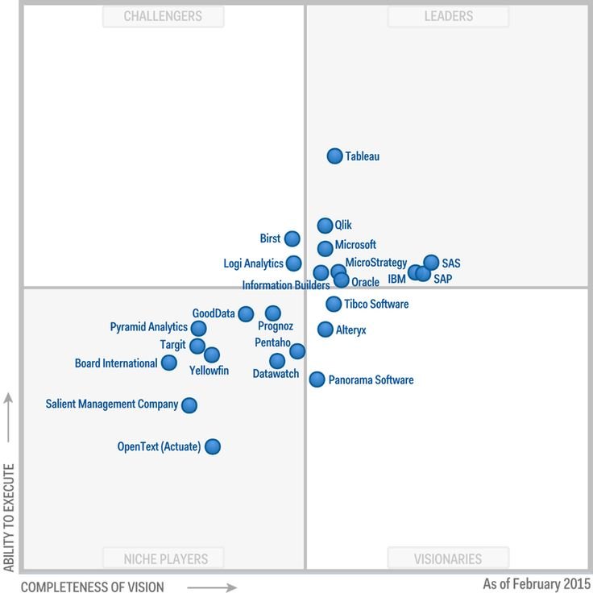








Data Analytic Tools
Notes:
Tableau
Power BI
Others
Strengths vs. Weaknesses

Slide 12
SEC
3
Interactive Demo

Slide 13
Demo
Things to think about
What do you want to know about the data? | What hypothesis do you have about the data? | What visualizations can you use with this data?
Datasets
Survey Data South vs. Midwest How do people identify states in the South vs. Midwest Food World Cup How much people like food of different ethnicities Flying Etiquette What is acceptable while flying? Oxford Comma What’s the appropriate way to use an Oxford Comma? | Business Data AirBnB Review scores, Prices, Beds, and House Types for AirBnBs in NYC Movie Review Comparisons Review scores for Fandango, Rotten Tomatoes, and IMDb Biopics Demographic information about subject along with Box Office results Daily Show Guests Daily Show guests by show | Public Safety / Sector Data Police Killings Demographic information about who police have killed Hate Crimes Hate crime frequency per state Car crashes and Insurance Premiums Car crashes (w/ reason) and premiums by state Airline Safety Incidents / Fatalities by airline over time College Majors and Incomes College majors, Gender make-up, and income figures Births by day Births by day from 1994 to 2014 Washington Post Unsolved Homicide Homicide Rate vs. Arrest Rate for Top 50 Cities
Notes:
Ask audience which dataset they are most interested in.
What do we want to know about the data?
List out the questions we would like answered.
What the audiences hypothesis?
Take a look at the data set
Explain the variables
Possible limitations or challenges with data
Tableau Demo
Connecting to the dataset
Build an executive summary
Building interactive visuals
Answer the questions
Power BI Demo
Connecting to the dataset
Build an executive summary
Building interactive visuals
Answer the questions

Slide 14
SEC
4
Break

Slide 15
SEC
5
Viz-Off Team Activity

Slide 16
Viz-Off
Split up into sets of 2 teams
Different dataset per set of 2 teams
1 team uses Tableau, the other uses Power BI
Team report building
Executive Summary: Few KPIs / graphics for the dataset. Might have a higher text to graphic ratio.
In-Depth but Static: Single focus per screen. More graphics than Executive.
Interactive Graphs: Similar to In-Depth but also have sliders / slicers
Team Presentations
Showcase design
What they learned about the data
Challenges / Likes / Dislikes of the tool and dataset used
Notes:
Split up into teams
Half use Tableau, half use Power BI
Give data sets that were not used in the Demo
Possibly prepare a few questions for each dataset to spark ideas
Team report building
Executive Summary: Something that cuts down the dataset to a few key points. Might have a higher text to graphic ratio. In-Depth but Static: These have more graphics and focus on a certain aspect of the dataset per 'screen' (either single graphic or multiple in a dashboard). These won't have sliders / slicers
Interactive Graphs: Similar to In-Depth but also have sliders / slicers
We can float around the room: Help spark additional ideas, answer questions, offer tips/tricks.
Teams presentations
What they learned about the data
Any highlights
What challenges they had
What they like or dislike about the tool

Slide 17
SEC
1
Wrap-up/Conclusion

Slide 18
Wrap-up/Conclusion
What we learned
Likes and Dislikes
Things to keep in mind
Tips & Tricks
Any other questions

